Slide 1
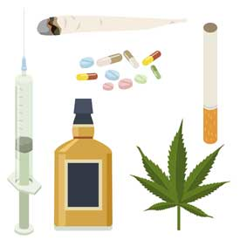
Alkohol und Drogen
Donnerstag, den 14. Mai
Learning objective:
To be able to understand a spoken text about alcohol and drugs

Slide 2
Translate into English
Man soll Alkohol vermeiden.
Man darf ein bißchen Schokolade essen.
Man muß keine Drogen einnehmen.
Man kann viel Sport treiben.
Man darf nur wenig Cola trinken.

Slide 3
Gesund oder ungesund?
Draw a table in your book with two columns labelled ‘gesund’ and ‘ungesund’
Read through the text and make a list in your table of all the healthy and unhealthy things you can find
Gesund | Ungesund

Slide 4
http://www.ashcombe.surrey.sch.uk/Curriculum/modlang/german/index_de_video.htm
Healthy Living -> Toxic substances.

Slide 5
Füllt die Lücken aus!
Complete the gap fill.
Come up to board to check your answers.

Slide 6
Schreib’ über dich selbst
Bist du Gesund? Schläfst du genug? Ißt du gesund? Treibst du Sport?
Write about 50 words about how healthy you are. If you would prefern, you can pretend you are sombody else (e.g. the person you wrote about on Monday).
Use some modal verbs to say what you don’t do that you perhaps should!

Slide 7

